Slide 1
RESTAURANT FOOD ORDERING SYSTEM
ARANYA SINGH CHAUHAN : RA1911028010008
PRANIT TANDON : RA1911028010014

Slide 2
MODULE 3

Slide 3
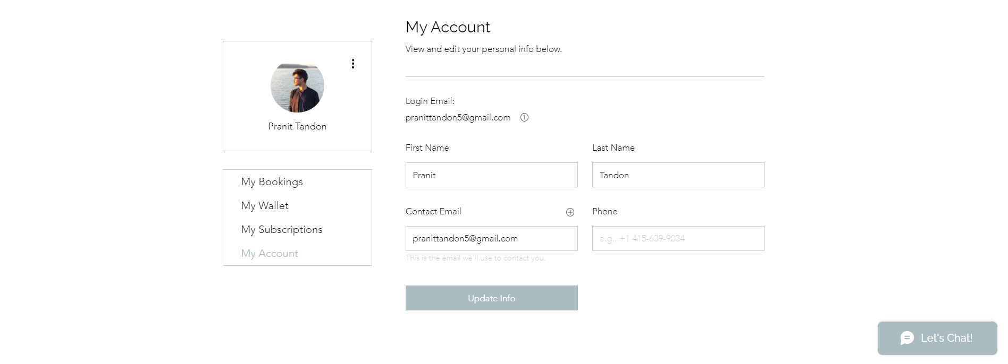
Update User Profile Page

Slide 4
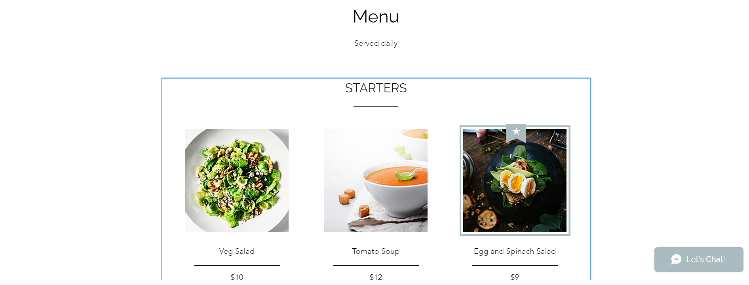
Sample Menu Page

Slide 5
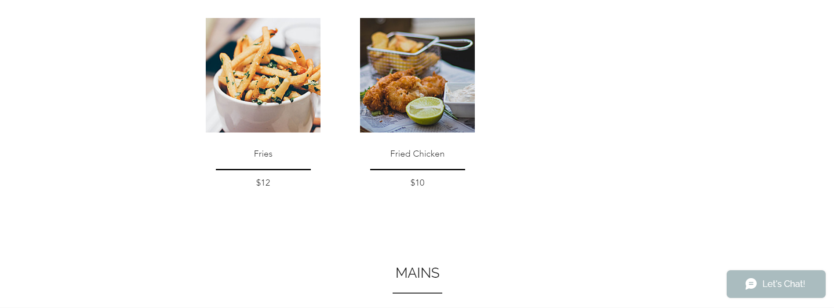

Slide 6
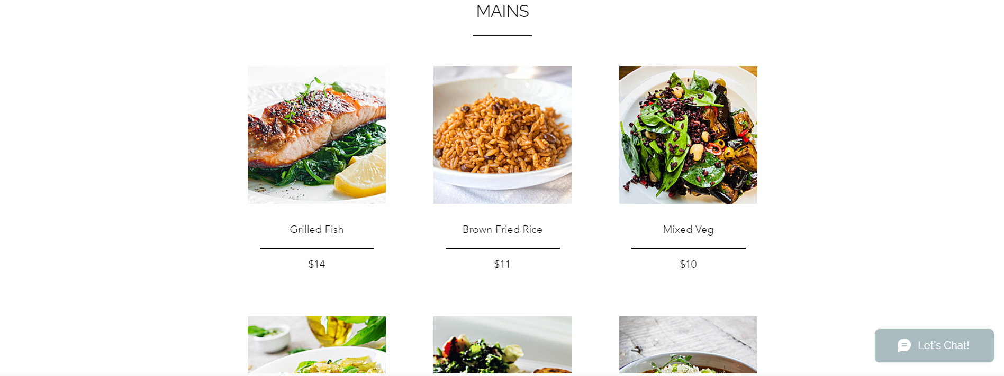

Slide 7
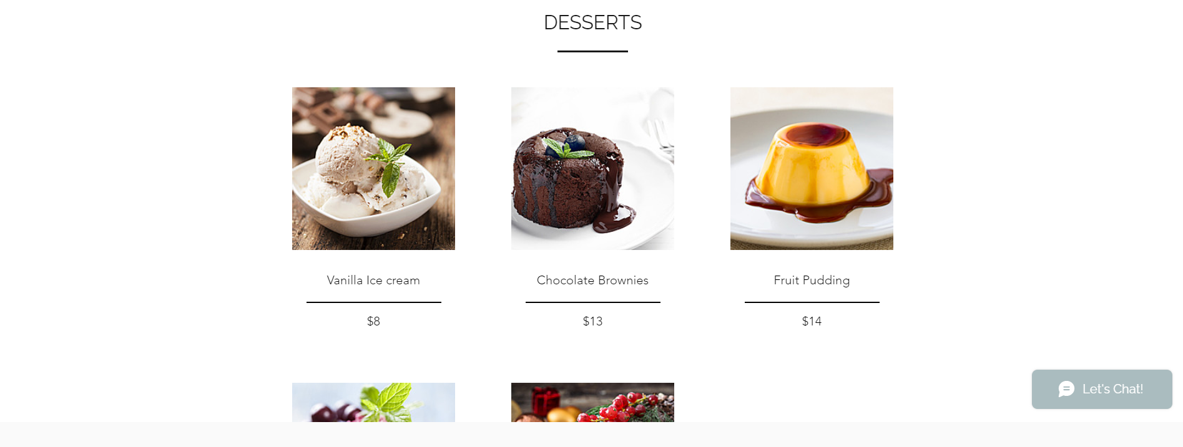

Slide 8
THANK YOU

